Slide 1
Psycholinguistic methods: An overview
Session 3
Vinicius Macuch Silva
Cognitive Modeling group

Slide 2


Slide 3
Quantitative
Behavioral tasks
Neuroimaging
Computational modeling

Slide 4
Behavioral methods
Context/ process
Reading
Listening
Method
Eye tracking while reading
Visual world eye tracking
Task
Read
Make a choice

Slide 5



Methods
Self-paced reading
Visual world eye tracking
Mouse tracking

Slide 6
Self-paced reading
Reading time (RT)
Sentence segment (word/ phrase)
Series of sentences
Button press (trigger)

Slide 7
Self-paced reading
Cumulative linear (word-by-word)
Non-cumulative linear (word-by-word)

Slide 8
Self-paced reading
Centered (word-by-word)

Slide 9

Self-paced reading
Eyes are a window onto cognition
RT reflects amount of time needed to process linguistic stimulus
Cognitive processing of language
Longer RTs
Shorter RTs
Processing difficulty
Facilitation

Slide 10
Self-paced reading
Ambiguity
Anomaly
Distance dependency

Slide 11
Reading ambiguous sentences
Occurs temporarily during reading but is resolved within the same sentence
Local ambiguity
Even after the whole sentence has been read ambiguity remains
Global ambiguity

Slide 12
Reading ambiguous sentences
The confident engineer maintained the debate would be easy to win.
The confident engineer maintained that the debate would be easy to win.
Trueswell & Kim (1998)

Slide 13
Reading ambiguous sentences
El perro mordió al cuñado de la maestra que vivío en Chile con su esposo.
“The dog bit the brother-in-law of the (female) teacher who lived in Chile with her husband.”
El perro mordió a la cuñada del maestro que vivío en Chile con su esposo.
“The dog bit the sister-in-law of the (male) teacher who lived in Chile with her husband.”
Dussias (2003)

Slide 14
Self-paced reading
Ambiguity
Anomaly
Distance dependency

Slide 15
Reading anomalous sentences
Error recognition and grammaticality paradigms
Grammar violations
Inconsistent or noncanonical permutations of linguistic stimuli
Word order, semantics, discourse, and other syntactic and extrasyntactic factors

Slide 16
Reading anomalous sentences
Veo que tu padre es de Texas.
*Veo que tu padre son de Texas.
“I see that your father is/ *are from Texas.”
Foote (2011)

Slide 17
Reading anomalous sentences

Slide 18
Self-paced reading
Ambiguity
Anomaly
Distance dependency

Slide 19
Reading sentences with distant dependencies
Computation or recognition of two non-adjacent syntactic elements
Distance dependency

Slide 20
Reading sentences with distant dependencies
The key to the cabinets was kept in the main office.
The key to the cabinet was kept in the main office.
Jiang (2004)

Slide 21
SPR and the psycholinguistic agenda
Simultaneity/ sequentiality of multiple plausible analyses
Immediacy of different types of linguistic information
Heuristics motivate different processing preferences
Cross-linguistic variation of basic principles

Slide 22
Methods
Self-paced reading
Visual world eye tracking
Mouse tracking

Slide 23
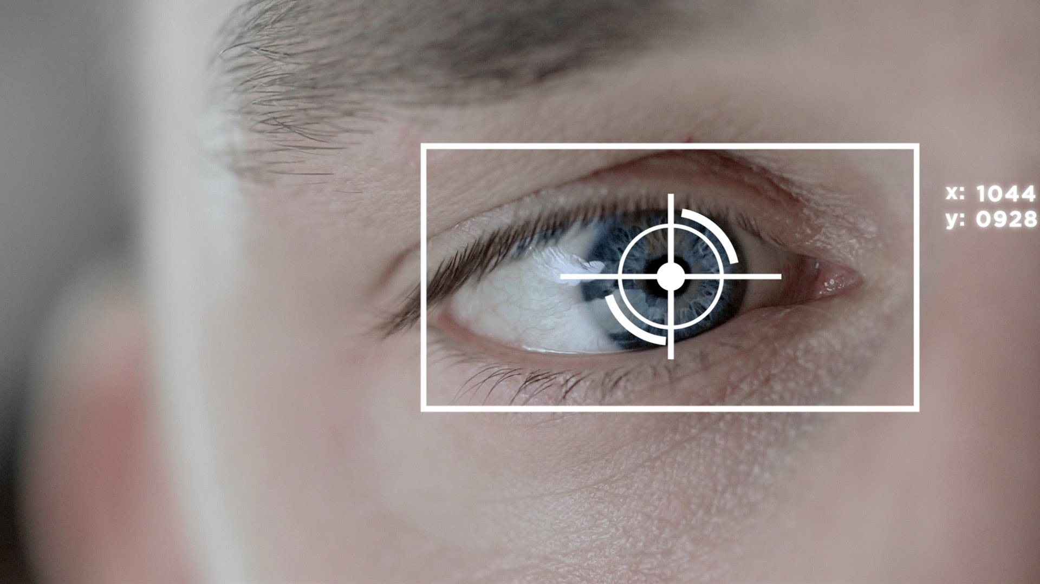

Slide 24
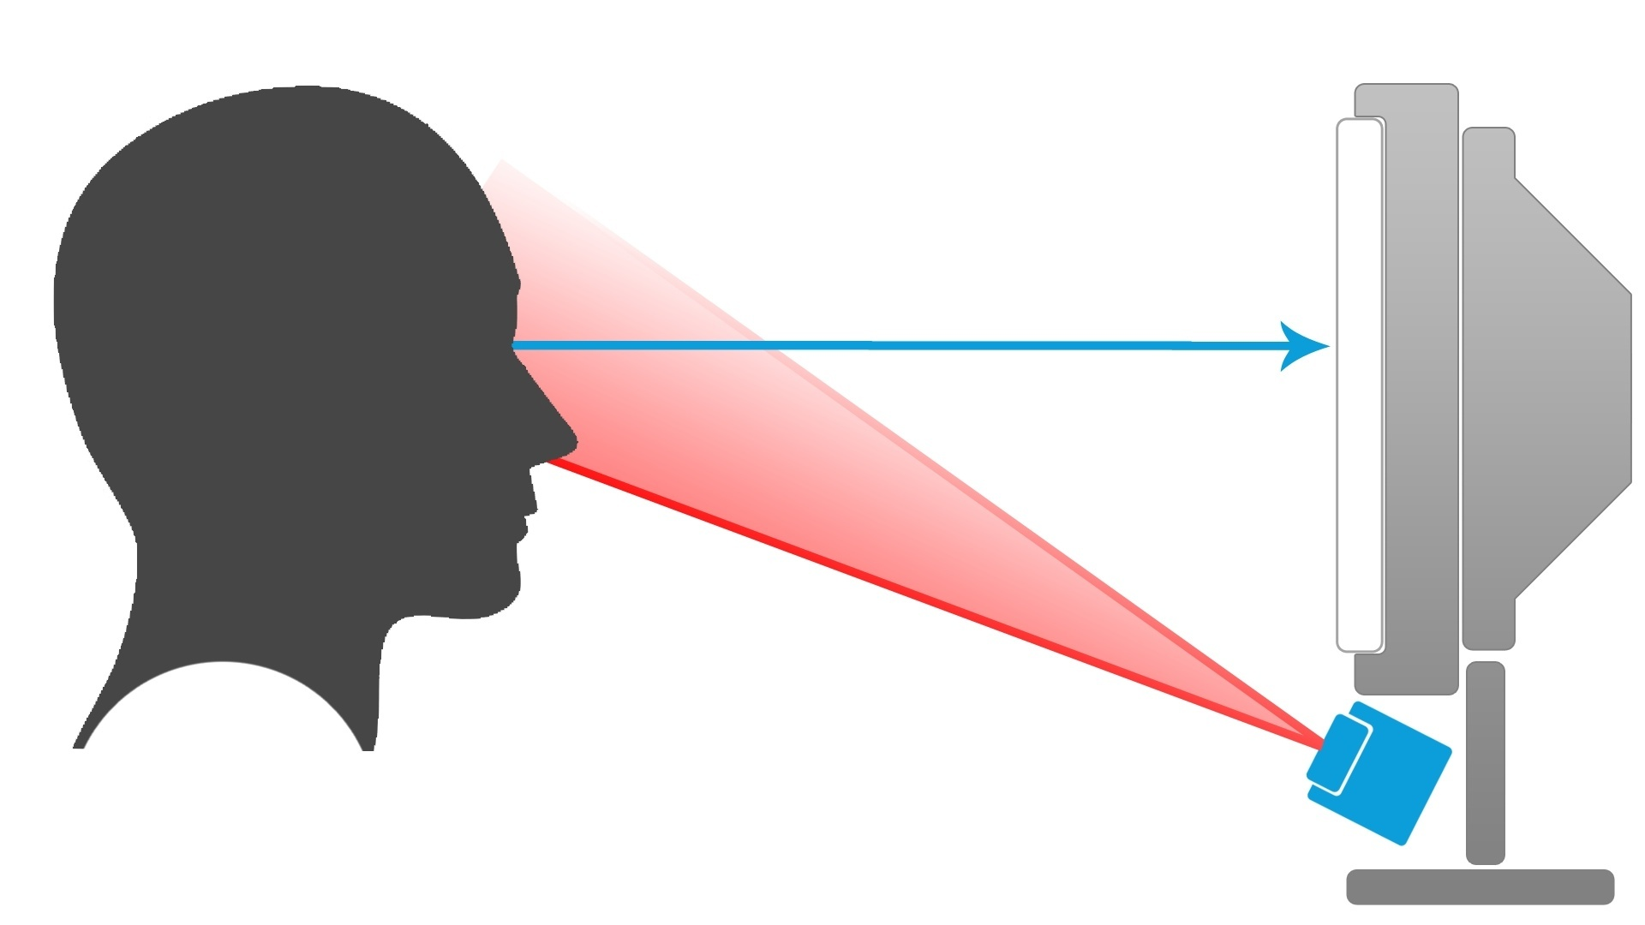

Slide 25
Visual world eye tracking
“Practical new research tool for the real-time investigation of perceptual
and cognitive processes and, in particular, for the detailed study of speech
perception, memory, and language processing”
Cooper (1974)

Slide 26
Display types

Slide 27
Task
Instructions > direct action task
Descriptions or comments > look and listen task
Advantage: Listeners do not perform metalinguistic judgments

Slide 28
Task
Integration of visual and spoken input > deliberate or automatic?
Graded automaticity (intentionality, controllability, goal dependence, etc)
Eye movements reflect direction of visual attention

Slide 29
Data analysis
Likelihood of participants looking at regions of interest at different times during a trial
Dependent variables: Fixation proportions/ counts of saccades

Slide 30
Data analysis
Statistical analysis: Differences in inspection likelihood for two regions of interest during each of a set of consecutive time windows
Result interpretation: Fixations & saccades are discrete events
Data from a single trial >/ continuous processing of the speech signal

Slide 31
Visual world and pragmatics

Slide 32
Situation-specific interpretation
Chambers et al. (2002)

Slide 33
Pragmatic inferencing
Sedivy et al. (1999)

Slide 34
Pragmatic inferencing
Huang & Snedeker (2009)

Slide 35
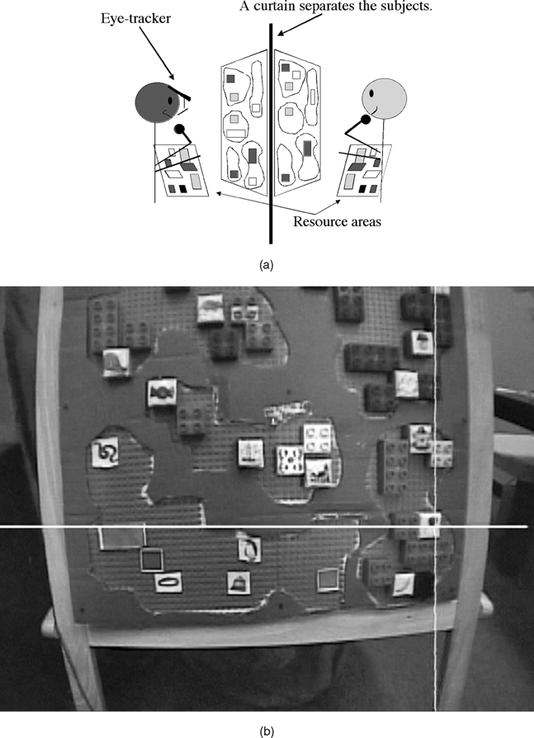
Dialogue
Brown-Schmidt & Tannenhaus (2008)

Slide 36
Dialogue
Hanna et al. (2003)

Slide 37
Visual world and the psycholinguistic agenda
Combination of linguistic information, visual information and social aspects of the test situation
Language users' eye movement are systematically related to their linguistic processing
Interplay btw. language, vision, memory and attention

Slide 38
Methods
Self-paced reading
Visual world eye tracking
Mouse tracking

Slide 39


Slide 40


Slide 41
Method resolution
2 to 3 data points (button presses)/ second
3 to 4 data points (saccades)/ second
30 to 60 data points/ second

Slide 42
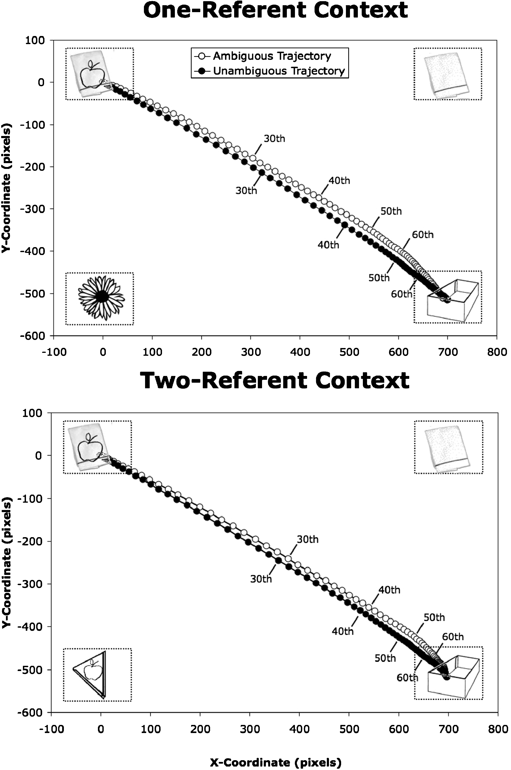
Farmer et al. (2007)

